Slide 1
Java 8 – SE 1 Presentation
Chapter 5 – Class design

Slide 2
Previous questions leftover
Question: Why can a parameter name be the same with the field name in a class ?
Answer:
- As we discussed before, the ... of field is ... and the ... of parameter is ... => This is confirmed in Java Specification (link note 1)
- The question that we are asking right now was mentioned in .... book => This is a phenomenon called ...ing (I forgot abt this ☺ )
- A field is considered as ... in a code ... if there are any ... that has the ... name with the ... name (link note 2)
- In order to access shadowed ..., ... name must be used
Notes:
Note 1: https://docs.oracle.com/javase/specs/jls/se8/html/jls-6.html#jls-6.3:~:text=The%20scope%20of%20a%20declaration%20of,the%20method%2C%20constructor%2C%20or%20lambda%20expression.
Note 2: https://docs.oracle.com/javase/specs/jls/se8/html/jls-6.html#jls-6.3:~:text=Example%C2%A06.4.1%2D1.%C2%A0Shadowing%20of%20a%20Field%20Declaration%20by%20a%20Local%20Variable%20Declaration

Slide 3
Introducing class inheritance
- When we create a new ... in Java, we could ... that class to "..." other existing ...
=> We call this as ...
- Inheritance is a ... where a ... inheriting all ... from ... (this include ... and ...) – (although all ... have been inherited but some of them won't be able to ... due to ...)
- For example, a class Z inherit a class A => Class Z is called ... and class A is called ...
– Java support ... inheritance => which mean that each of the ... can only have ...
- Java also support mutli ... => Which mean that a class can ... other class and that other class can ...
- Java doesn't support ... inheritance (means that a class can have ...) because it causes ... and harder to ...
- If we want a class that can't be ... by other ... => use ... keyword

Slide 4
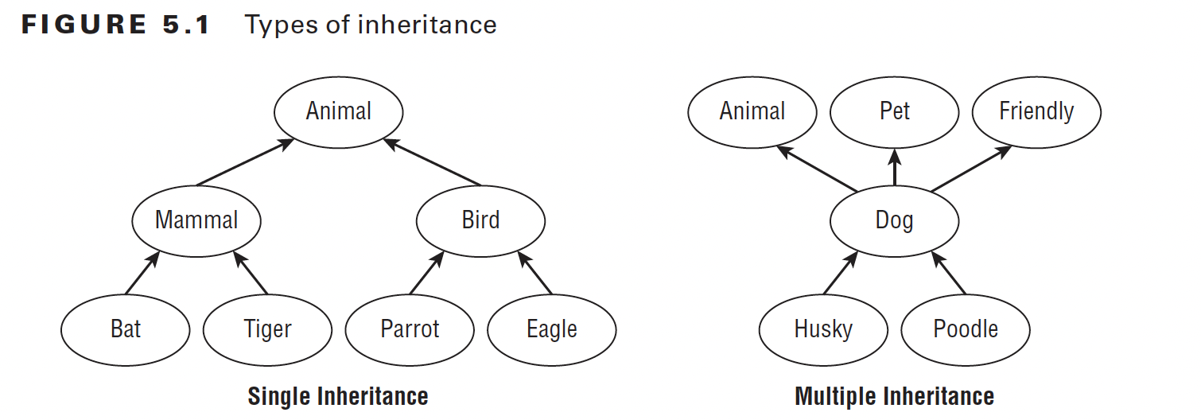
Introducing class inheritance

Slide 5
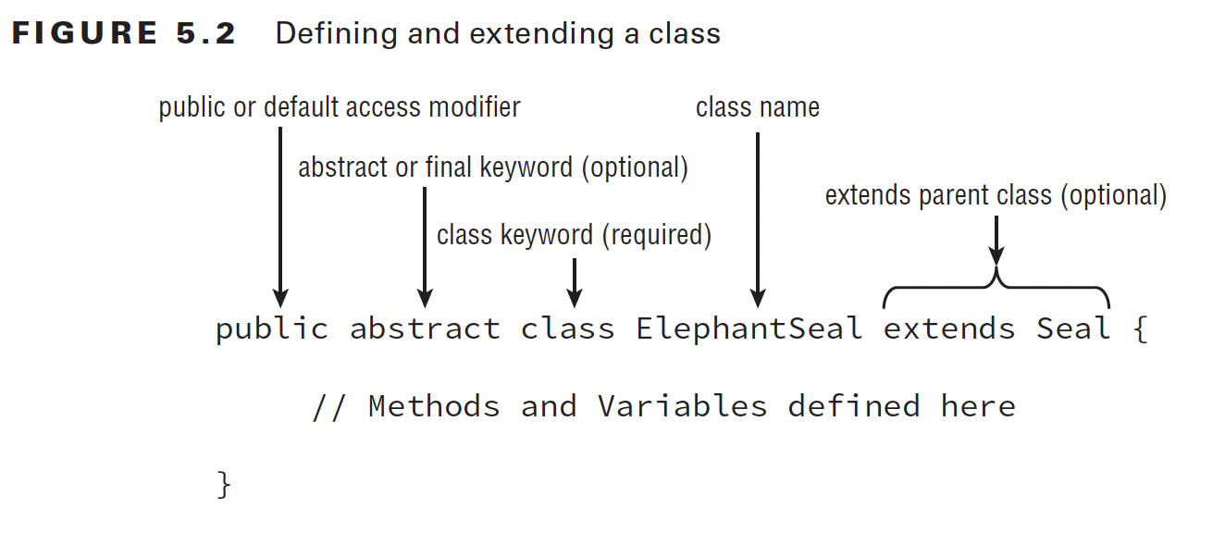
Introducing class inheritance – extending a class
- This picture below is the ...
(code illustration snippet 1)

Slide 6
Introducing class inheritance – extending a class
- Although not all ... can be ... from Lion, but Lion still ... all of ... from Animal class => Technically, we can base on this and conclude that Lion object is ... than Animal object because Lion object has ... from ... and also have its ... (although not all ...)

Slide 7
Introducing class inheritance – Apply access modifier
- With all ... of modifiers that we have studied => we could ... in class
- Note: In OCA exam, we only use ... and ... modifier for ... classes (which is the ... classes), the others are used in ... classes (classes where the ...) which are out of scope of OCA exam
– If a class uses ... modifier => ?
- If a class uses ... modifier => ?
– A ... file can have many ... but can only have ... class => The ... file name must be ... with the class that have ... modifier
– An ... of using ... modifier is that we can have multiple ... within only ... file
(code illustration snippet 2)
- All ... for modifier are also ... to interface

Slide 8
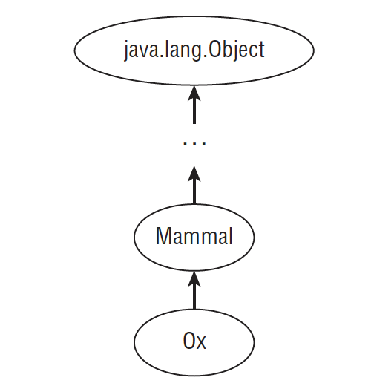
Introducing class inheritance – Creating Java Objects
- No matter how hard we try, all classes will ... the "..." class.
- Because the ... class is the 2nd ... class => It won't ... any other class => it will automatically ... "..." class
- Object class is the only class that ...
(code illustration snippet 3)

Slide 9
Introducing class inheritance – Defining constructor
- In normal case, if a class that doesn't have ... => ... will automatically ...
- However, in inheritance, things will behave differently
– In inheritance, the 1st ... of the ... will have ... cases:
+) Case 1: It will call other ... within a ...
+) Case 2: It will call to the ... of the ... class (If the ... class ... requires param => ... also requires param). This case happen because of a idiom:
"If a ... wants to be ..., ... must be ... first"
(code illustration snippet 4 – 5)
- If the ... class has multiple ... => the child class can use the ... class constructor at any context (as long as they pass in ...)
(code illustration snippet 6)

Slide 10
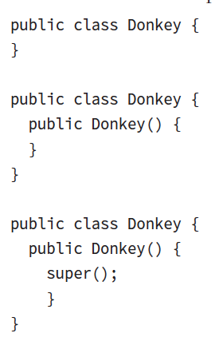
Introducing class inheritance – Understanding Compiler enhancement
- If a class doesn't create its ... => Compiler will ... and also add to the first ...
– If a class does create its ... but doesn't include ... => Compiler will ...
=> In all ..., the compiler will ... likes this picture

Slide 11
Introducing class inheritance – Understanding Compiler enhancement
- However, what happen if the parent class only have ... (and that ... requires ...) and the ...class doesn't have any ...
=> The compiler won't need to ... at the parent class because it ..., however, when it try to ... at the subclass, it sees that the parent class only has ... while the ... that it is trying to ... doesn't requires parameter => ...
(code illustration snippet 7 – 8 – 9)
- Reviewing constructor rule:
+) ... (ask question Q5)
+) ...
+) ...
+) ...
+) ...

Slide 12
Introducing class inheritance – Calling constructor
(code illustrations snippet 10)

Slide 13
Introducing class inheritance – Calling inherited class member
- Java classes always have ... access to the ... of the ... class (if they have ... and ... ....). If the ... class and the ... class are also in the same ... => they can also have ... access
- However, once the ... are set with ... modifier => no ... (unless the class has ...)
(code illustration snippet 11)
- If the inherited field has a ... => We can refer to them ... or by using ... variable
- We can also ... to inherited field from ... by using ... keyword
(code illustration snippet 12 – 13 - 14)
- the ... "super" and the ... "super()" are completely different. One is used for ... and one is used for ... => They are not ...
(code illustration snippet 15)

Slide 14
Introducing class inheritance – Overriding a method
- As I mentioned in the beginning of the presentation, "inheritance" is a .... => which means that it also ...
- What happen if we ... same method on both ... class and ... class ? => We could do that by Overidding the method
- Override is when we re-... a method on ... class that has the same ... with the ... of the method on ... class
- If we want to call ... on the parent class => we use ... keyword
(code illustration snippet 16)
- Some rules when ... a method:
+) ...
+) ...
+) ...
+) ...
– Method ... and Method ... are albeit the same, however Method ... is different from Method ... when using .... Method ... must use ... while Method ... can alter ... => Freely to use ...
(code illustration snippet 17 – 18 – 19)

Slide 15
Introducing class inheritance – Redeclaring a "private" method
- ... a ... method from parent class is impossible. However, it doesn't mean that we can't create ... as the method on ... class
- However, it won't be Method ... anymore, it will be a ... => which means that all rules from Method ...
(code illustration snippet 20)

Slide 16
Introducing class inheritance – Hiding Static Method
- Hiding static method is the same as Method ..., except for an additional rule for Method ... rule:
+) The context of using "..." keyword in ... class must be the ... as when using in ... class
For example: The method in ... class is using ... => The method in the ... class must be .... If the method in ... class doesn't use ... => the method on the ... class is also ...
(code illustration snippet 21 - 22)
Ask question about "Overriding VS Hiding Methods" section (Q1, 2)

Slide 17
Introducing class inheritance – Creating final method
- The use of "final" ... in method is means that ...
– A method should only be ... as "final" only when we sure that the ... of the method in ... class won't ... when ... to the ... class. (use mammal as an example)
(code illustration snippet 23)
(Ask question about hiding variable section, Q3, 4)

Slide 18
Creating Abstract class
- Lets say for example, we want to create a ... class for other devs to .... Our objective is to provide some ... and ... for the devs to use. And then, devs will ... the provided ... or create .... Also, we want our class can't ...
=> We can ... by using "abstract" ...
- In Abstract ..., we have a ... called Abstract...
– Abstract method is a method where ...
(code illustration snippet 24)

Slide 19
Creating Abstract class – Defining an Abstract class
- Unlike what I have been taught with Abstract class definition (which is ...), however, an Abstract class can have ...
(code illustration snippet 25)
– Class that use ... keyword => Can't ...ed
– Class that use "Abstract" ... => Must be ...
=> When ... these 2 keywords => there will be ...
(code illustration snippet 26)
- The ... thing also apply to ...
(code illustration snippet 27)
- Abstract method doesn't work with ... because if we set it to ... => There will be no ... concept => ...
(code illustration snippet 28 - 29)
- An abstract class is only useful when ... => The class that ... the abstract class are called "..." because it is the first ... class that ... the abstract class
– All class that ... the abstract class are required to ...
(code illustration snippet 30 - 31)

Slide 20
Creating Abstract class – Extending an abstract class
(code illustration snippet 32)
- An ... abstract class can ... other ... abstract class => When we doing this, the ... abstract class won't need to ... the ... on the ... abstract class
– If there are any concrete ... that ... the ... abstract class => that concrete ... will have to ... from both ...
(code illustration snippet 33)
- However, there are 1 .... If all ... from parent abstract class that has been ... by the sub-abstract class => the concrete class won't have to ...
(code illustration snippet 34)
- The reason for this is because when the ... abstract class ... the method from the ... abstract class => When a concrete class .. the ... abstract class => the method that the ... class ... down will be the ... version not the ... version
- Rules for Abstract class:
+) ... (Ask question , Q7 – also check package part1.q7)
+) ...
+) ...
+) ...
+) ...

Slide 21
Creating Abstract class – Extending an abstract class
- Rule for Abstract method:
+) ...
+) ...
+) ...
+) ... (ask question, Q6)

